Slide 1

SEMESTER PROJECT
PHONEBOOK DIRECTORY
Zaeem Muzammil Muhammad Ali Sajid

Slide 2




01
PHONEBOOK
02
LEARNING OBJECTIVES
CONTENTS
WORKING &
03
FLOW CHART

Slide 3

PART
01
PHONEBOOK

Slide 4





01.Phonebook
User’s Personal Phonebook directory, a simple console application without graphics. In this application, you can:
Add
Edit
Search
Delete
This adds a new contact number in the file, asks for number and name of contact, and adds up in the directory.
This modifies the contacts in the files, whenever the user enters the name, he enters a new number and saves it in the file.
One can search contacts by either entering name or number. Each leads to the contact for which the user searched.
One can delete contacts by either entering name or number. Each leads to the deletion of that particular contact.

Slide 5


Cont’d.
View Contact List
Exit Application
The User has also the choice to view all the contacts saved in the text file. This choice brings up all contacts on the screen.
The User can exit the application at any time by selecting the choice of exit from the main menu.

Slide 6
PART
02
LEARNING OBJECTIVES

Slide 7
02. Objectives
User-defined functions in Modular Programming for easy debugging and Modifying.
Getting Familiar with Data Structures.
6
Use of advanced level C++ programming language in different aspects.
2
4
5
File-Handling & File streams in C++. Read/Write operations on text files.
1
3
Using Unidimensional Arrays for structures and variables.
Understanding and use of different types of
built-in libraries in C++.

Slide 8
PART
03
WORKING & FLOWCHART

Slide 9
03. Working
Structures
To make a data structure of the contact, comprising of Name and Phone Number.
Modules
User-Defined Functions are used for each operation like structural arrays.
File Handling
Reading/Writing data to extracting data from files.

Slide 10
03. Working
Libraries
<fstream> (for file handling)
<iostream> (for input/output functions)
<string> (for string functions)
<windows.h> (for sleep() in start() function)

Slide 11
03. Working
Writing/Appending Data into the text file
Take inputs from the user of Contact’s Name & Phone Number. Save it in the “Person” structural array in main() function.
Using Read/Write operations of <fstream> header file, data in the array is written on the .txt file.

Slide 12
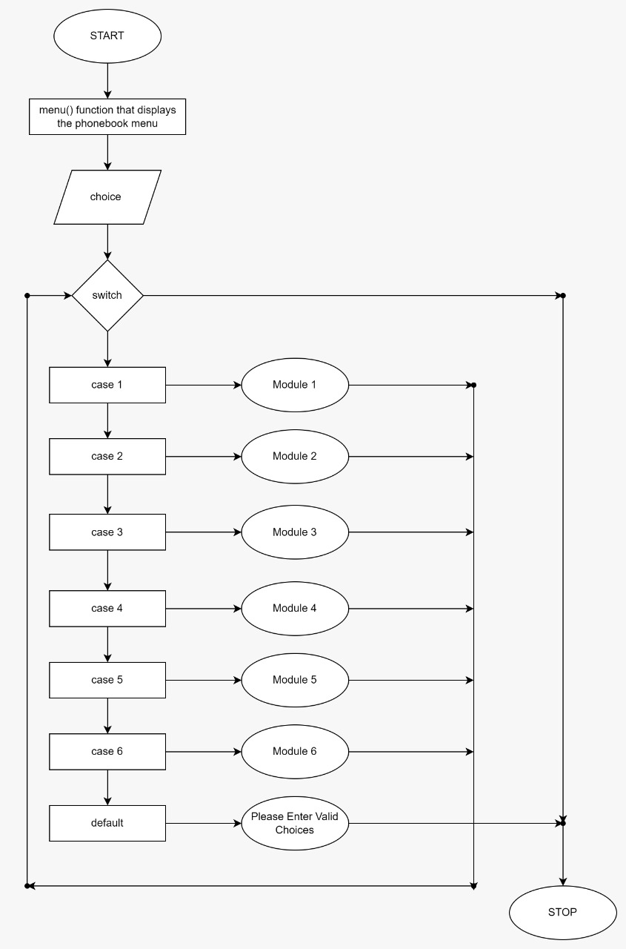
03. Flowchart

Slide 13
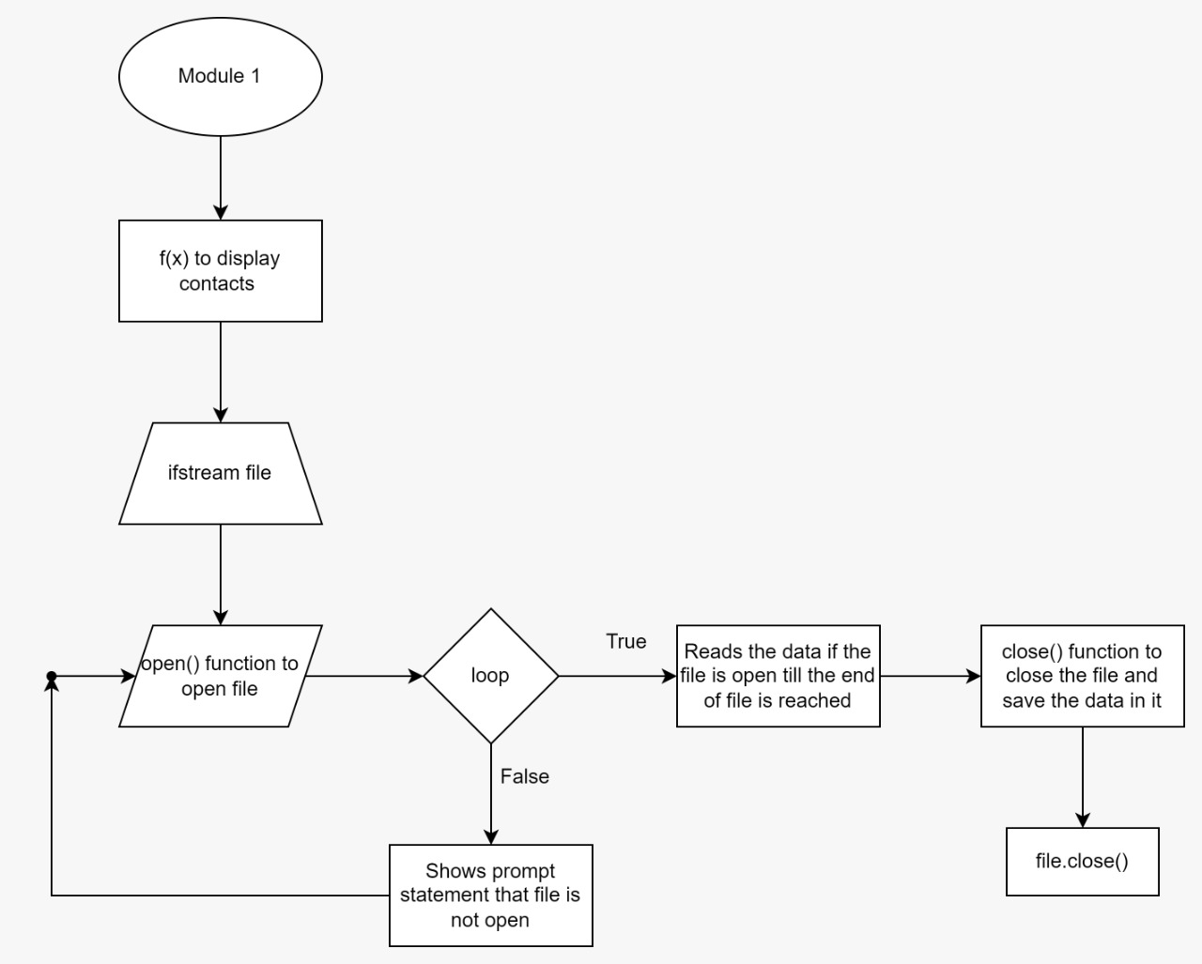
03. Flowchart

Slide 14
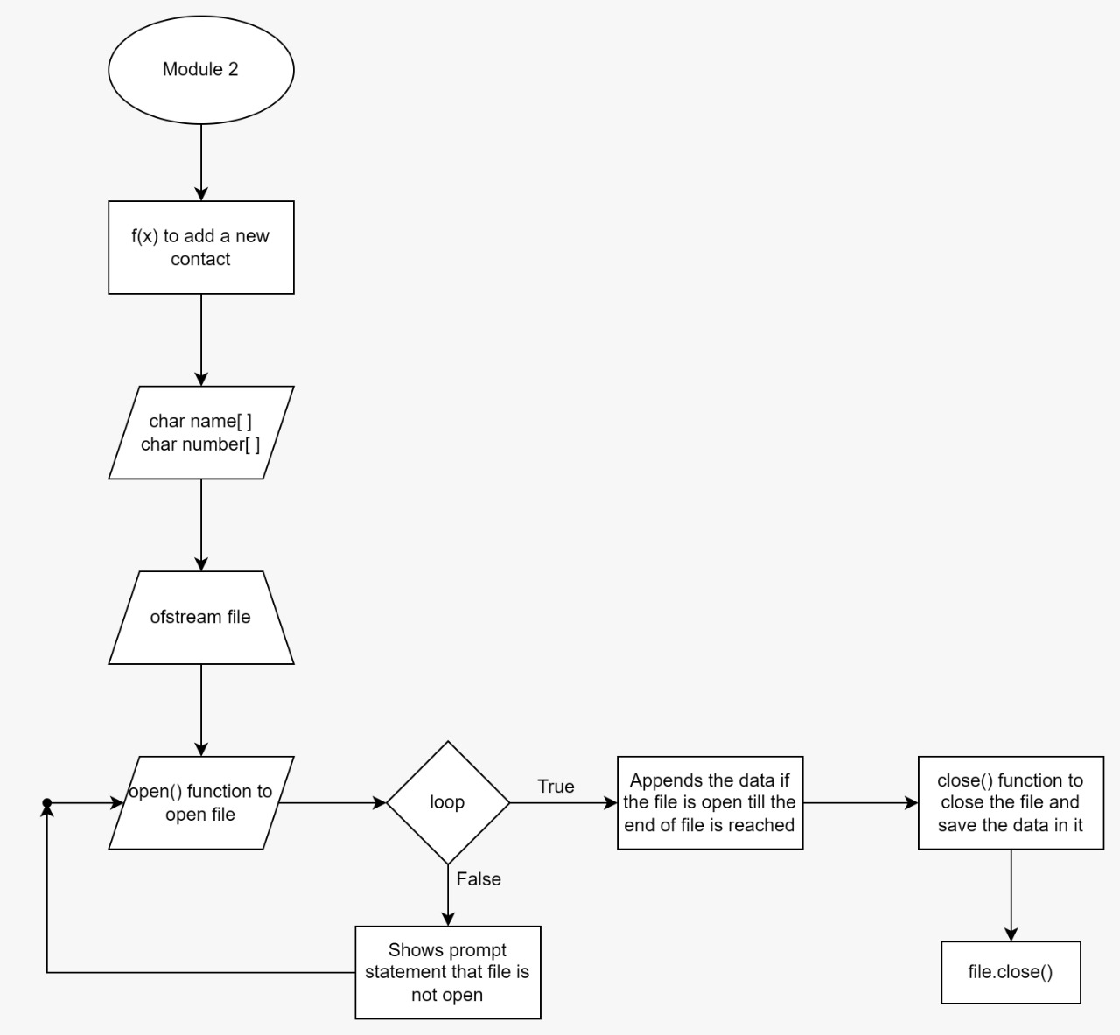
03. Flowchart

Slide 15
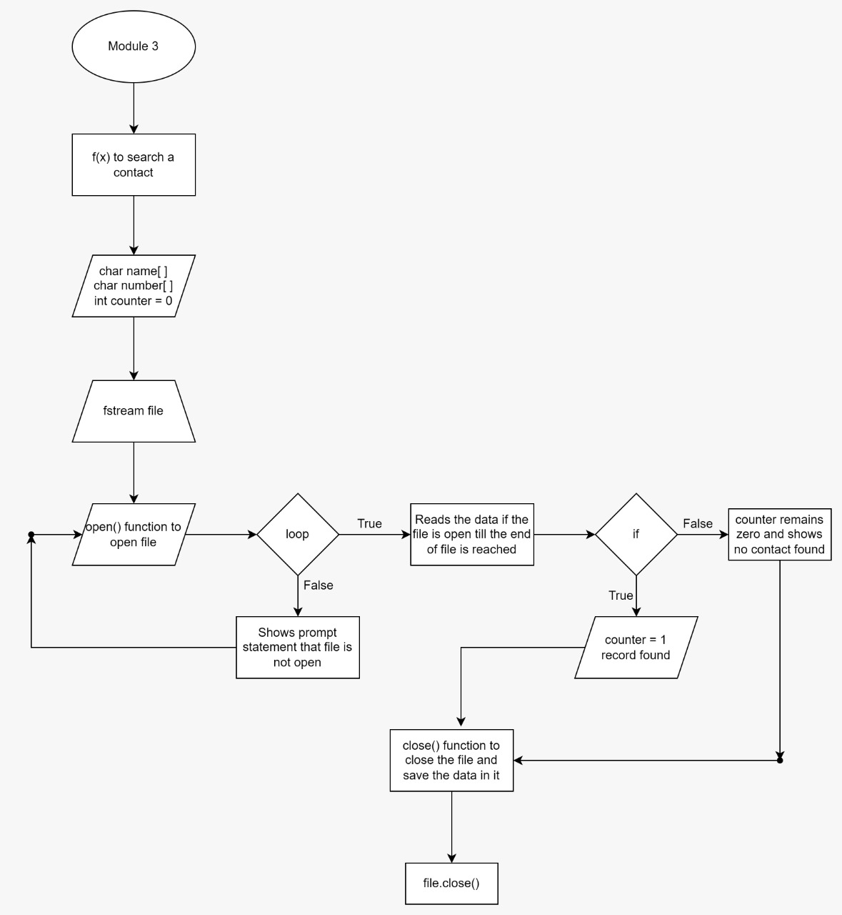
03. Flowchart

Slide 16
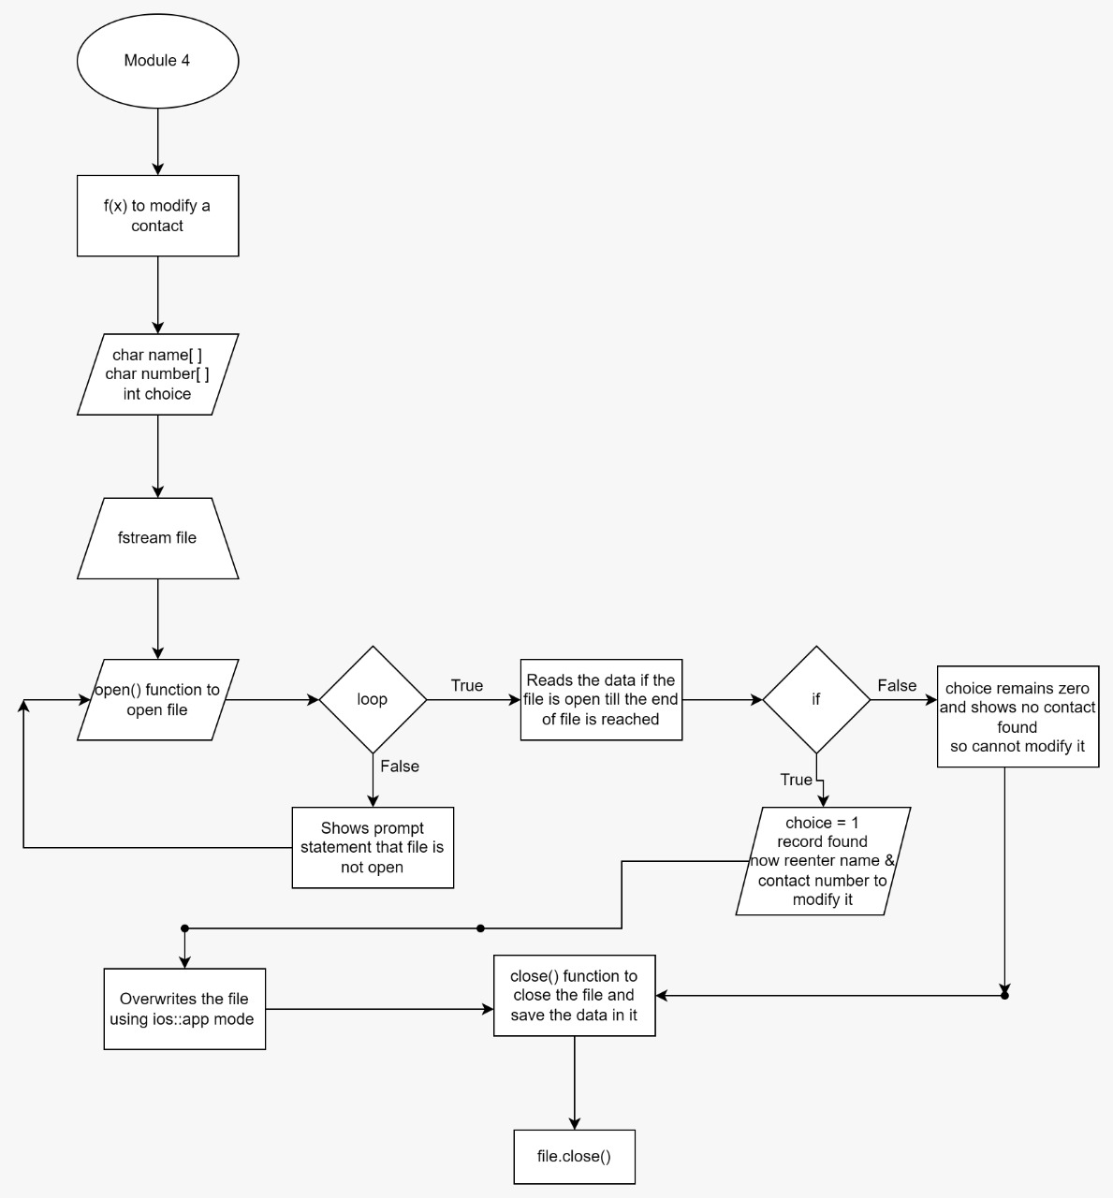
03. Flowchart

Slide 17
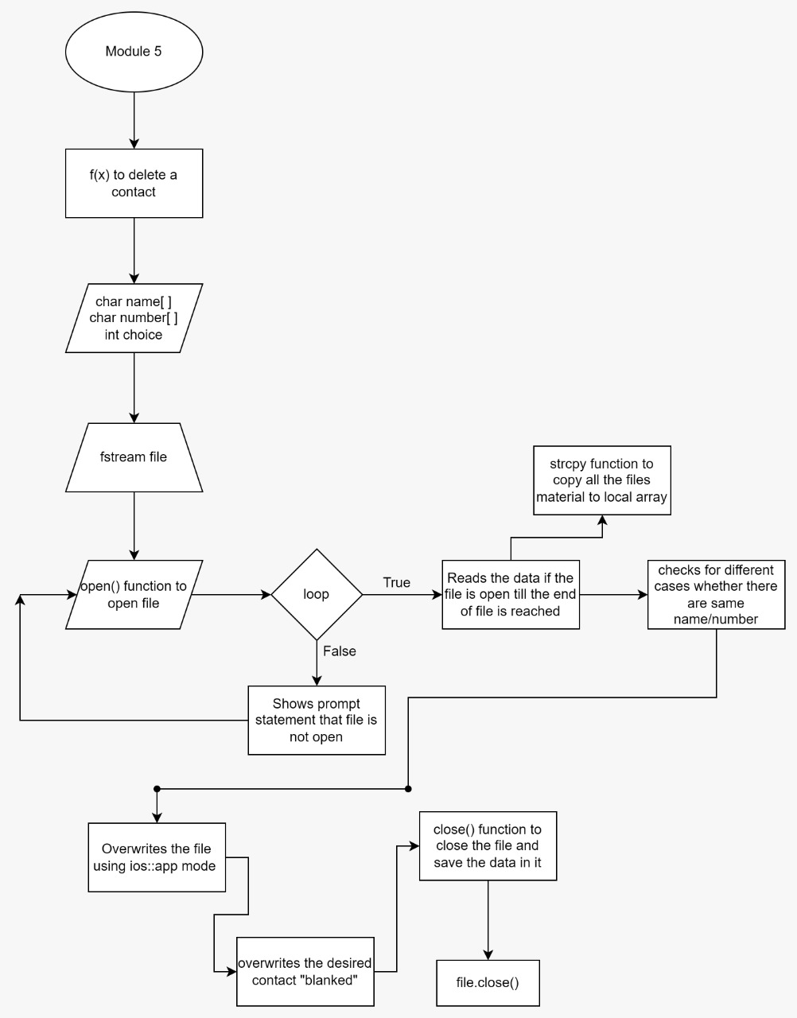
03. Flowchart

Slide 18
THANK YOU !

